Slide 1

CUSTOM ENCRYPTION
AND
DECRYPTION SOFTWARE
Group Members :
Lanka Sai Vara Prasanthi
Tamma V K S Prasanthi
Arepalli Lavanya
Nunna Surya Prabha
Gotari Kalavathi

Slide 2


Agenda
Introduction
Encryption
Decryption
Encryption Decryption Architecture
Client Server Architecture
Flow Chart
procedure
Program and Output
Conclusion

Slide 3

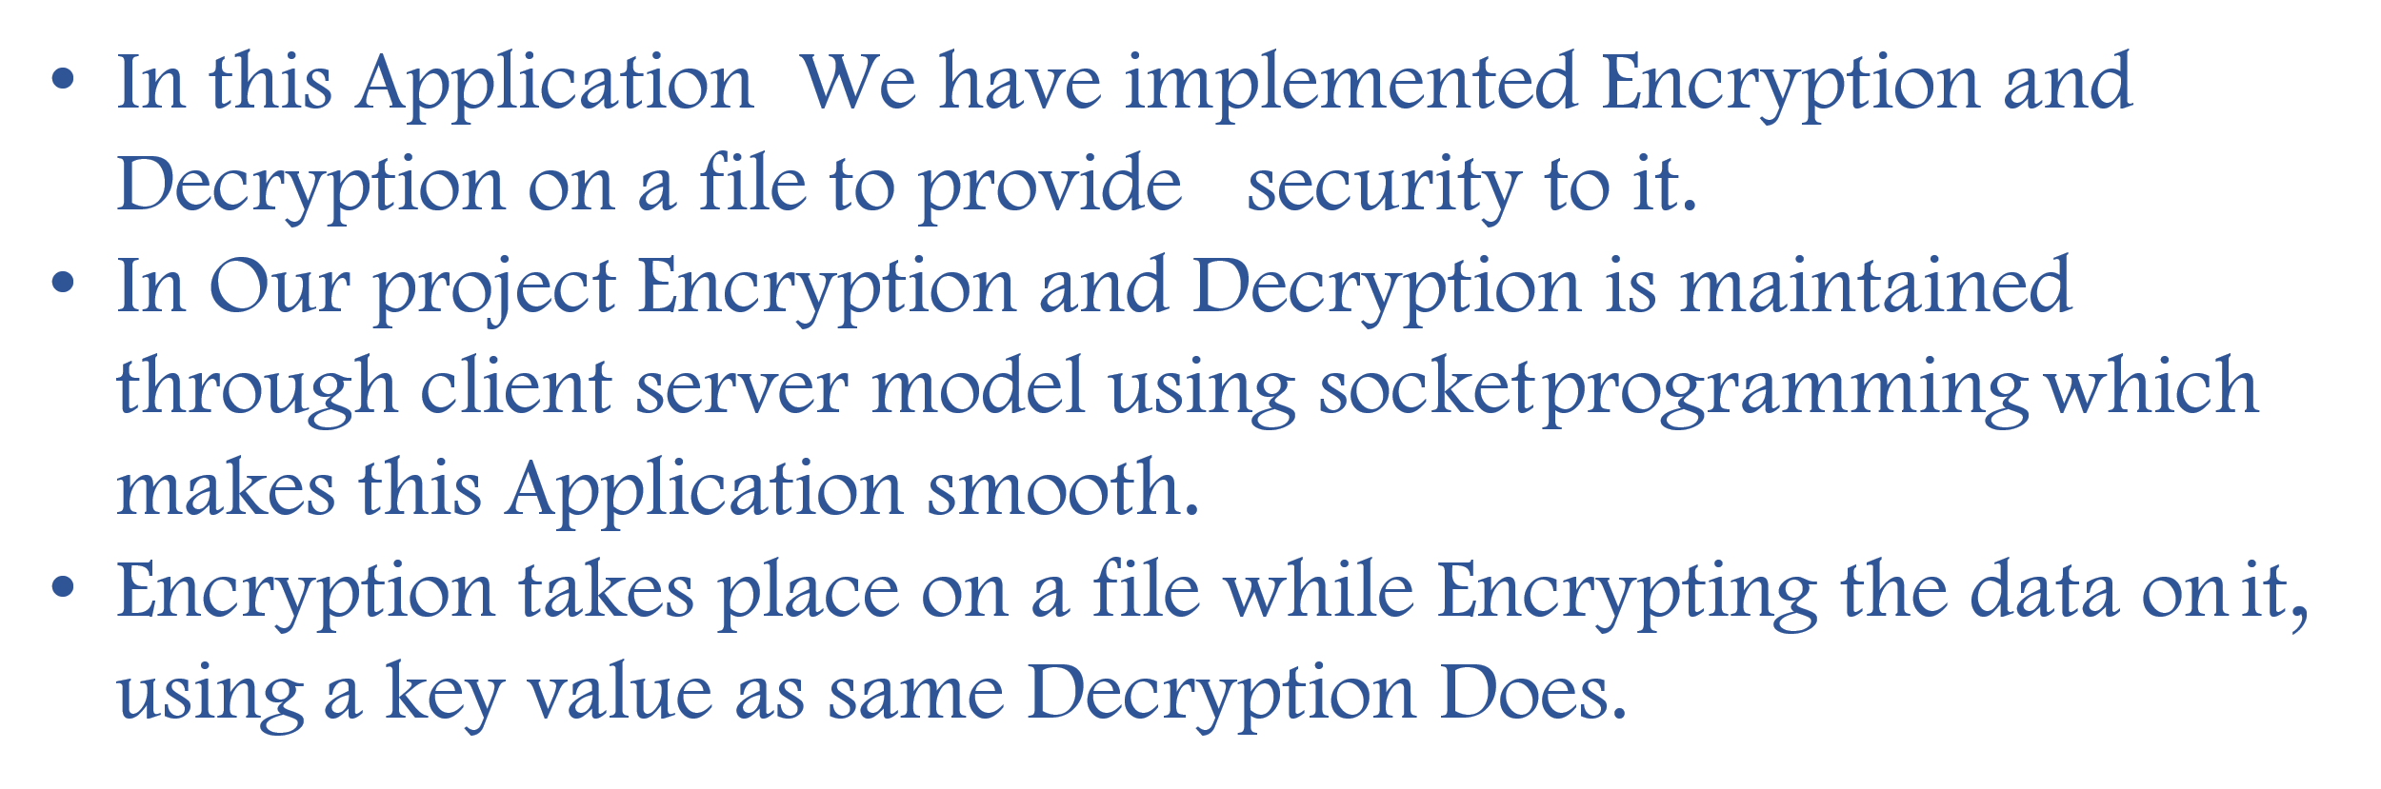
Introduction

Slide 4

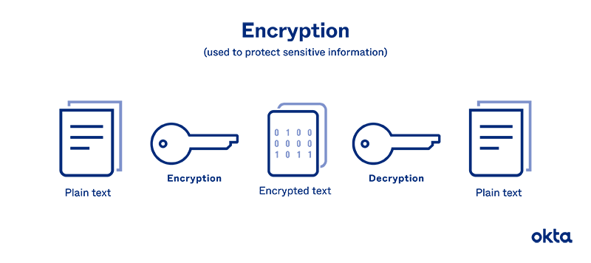
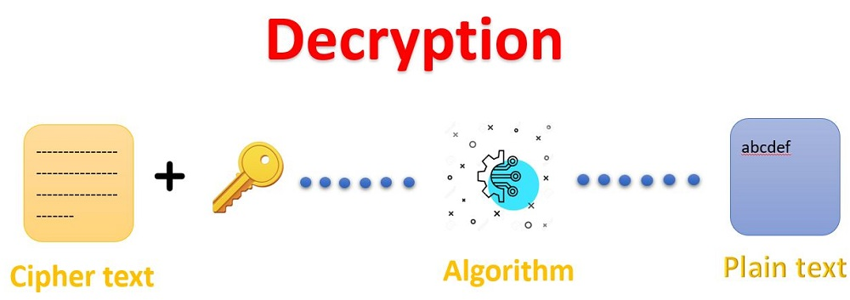
Encryption:
Encryption is the process of converting plaintext(readable text) into ciphertext (unreadable text)using any or algorithmic called a cipher. This is done to protect the data from unauthorized Access .
Decryption:
Decryption is the process of converting ciphertext (unreadable text) back into plaintext (readable text) using a mathematical algorithmic and a key. It allows the original plaintext to be read after it has been converted into ciphertext to protect the data from unauthorized Access.

Slide 5

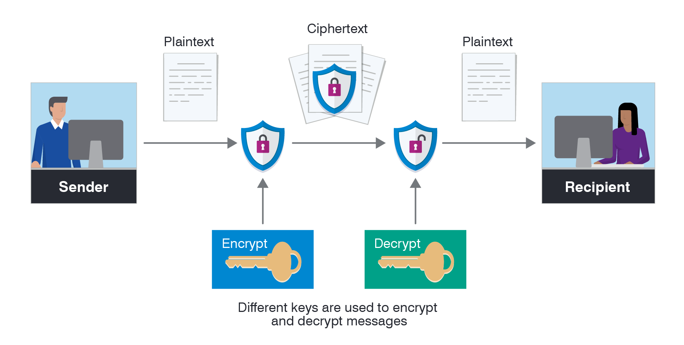
Encryption and Decryption

Slide 6

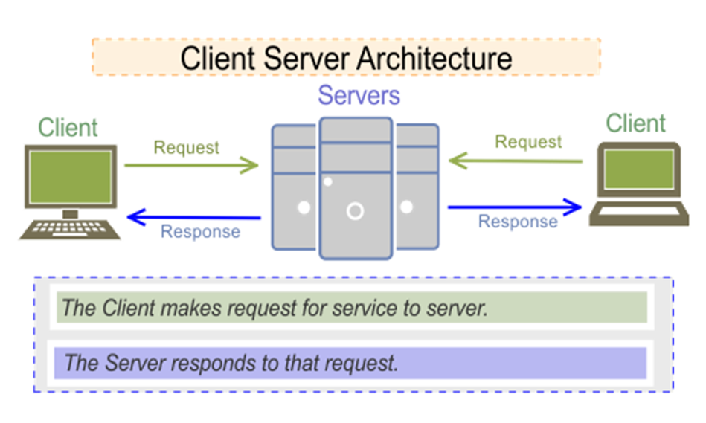
Client And Server
To be secure, both web traffic and messaging platforms must use cryptographic channels to secure communication between their applications' end points. In a web browser, TLS is the industry standard protocol for building those channels.
The Client Server Architecture is a model/design/structure in which the Client makes the request for any service and the server provides that service or responds to that request.

Slide 7

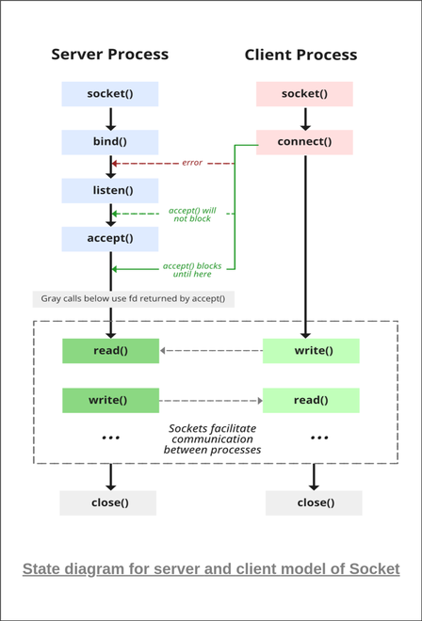
Socket Programming
Socket programming is a way of connecting two nodes on a network to communicate with each other. One socket(node) listens on a particular port at an IP, while the other socket reaches out to the other to form a connection. The server forms the listener socket while the client reaches out to the server

Slide 8

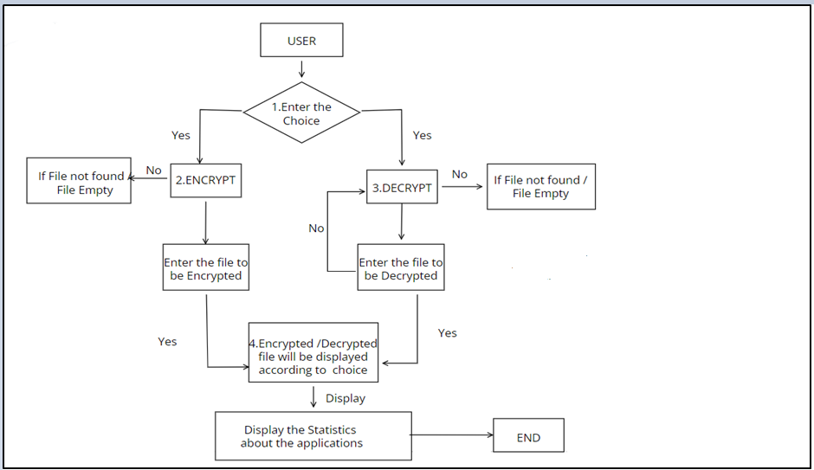
Flow chart

Slide 9

Procedure:
In this Application ,When We select a file to Encrypt ,the Encryption Process takes place by using a key value and stores in a memory then Decryption will perform.
After Encryption process takes place the result passes through client Server using socket programming through Decryption to decrypt the fie.

Slide 10

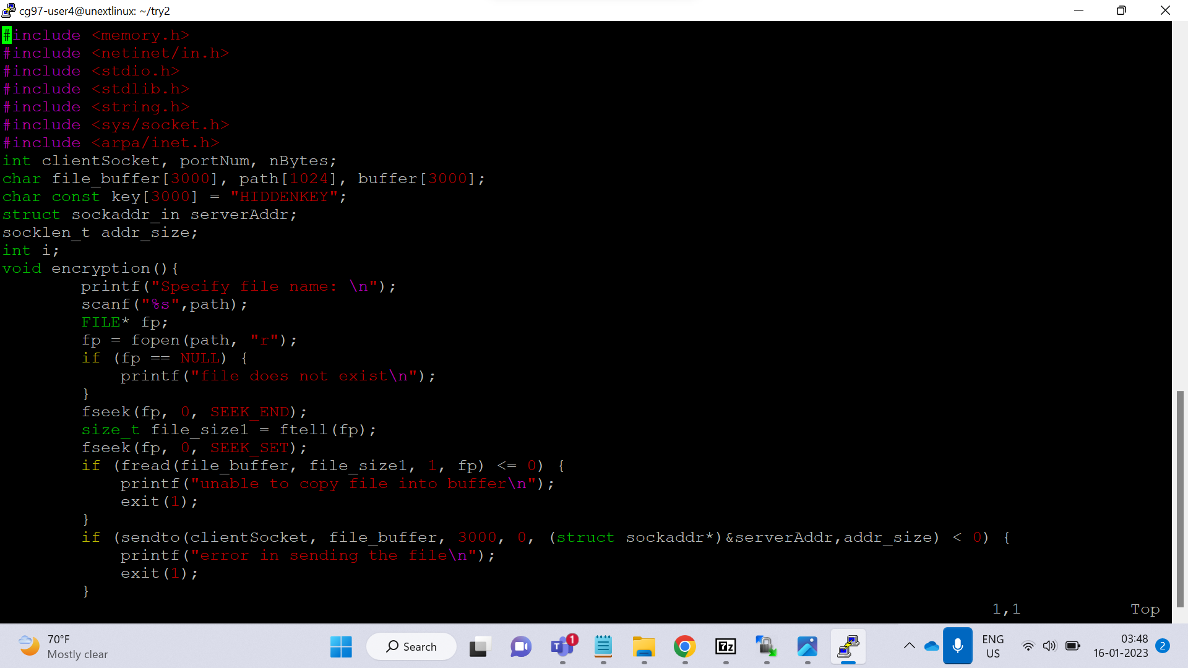
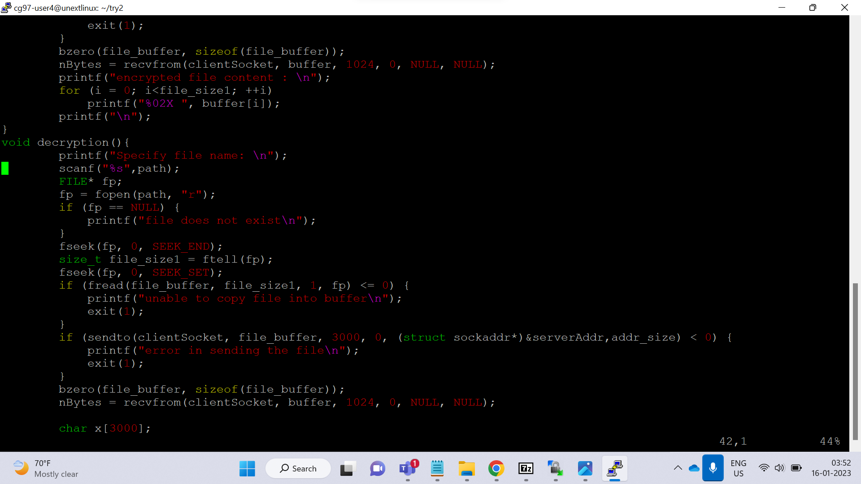
Program
Client

Slide 11
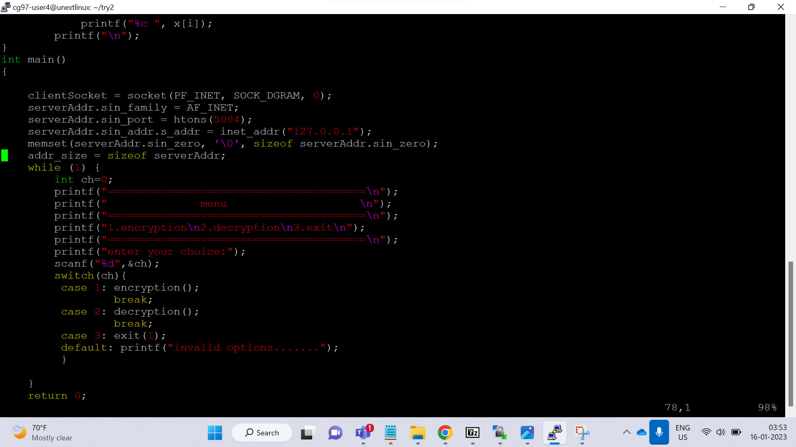

Slide 12
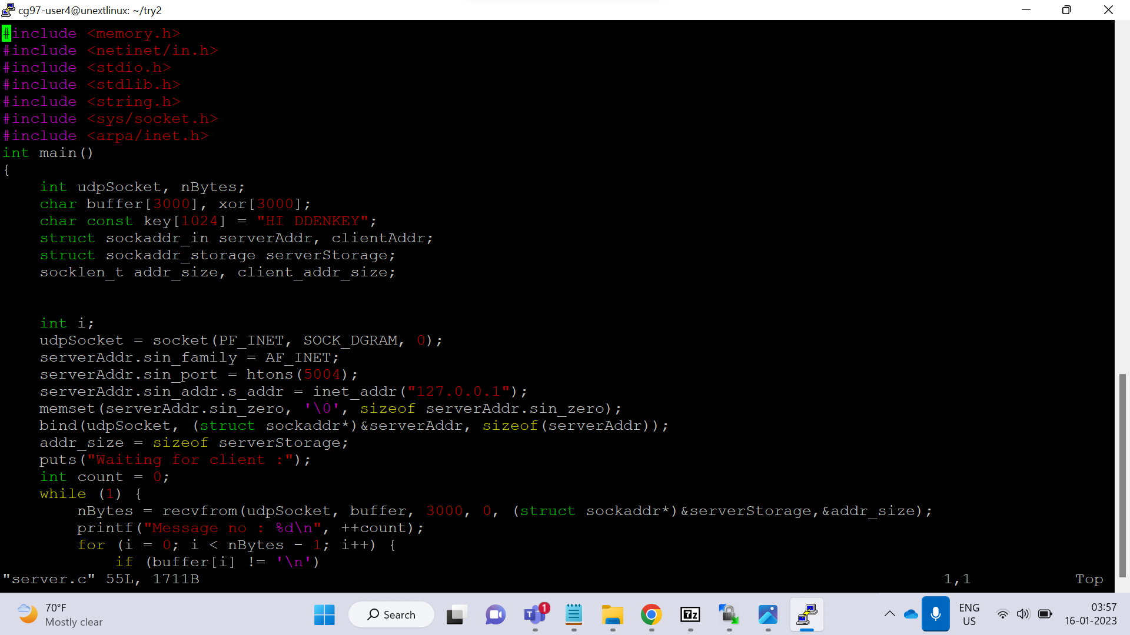
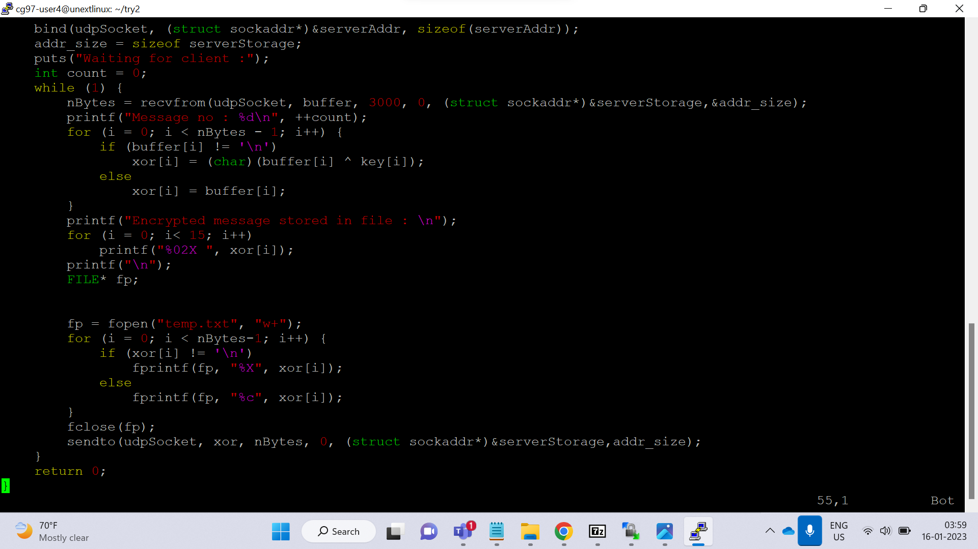
Server

Slide 13
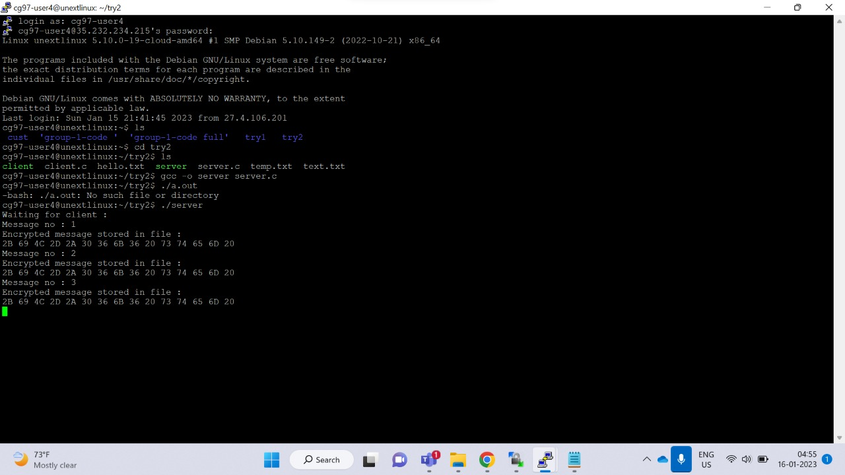
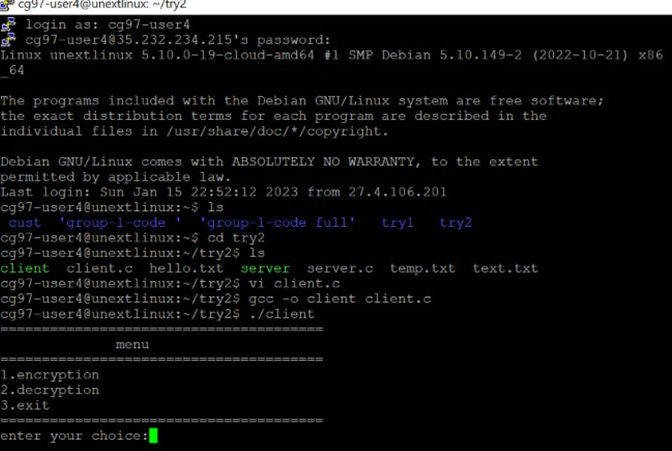
Outputs
Server Waiting for Client
Enter User’s Choice

Slide 14
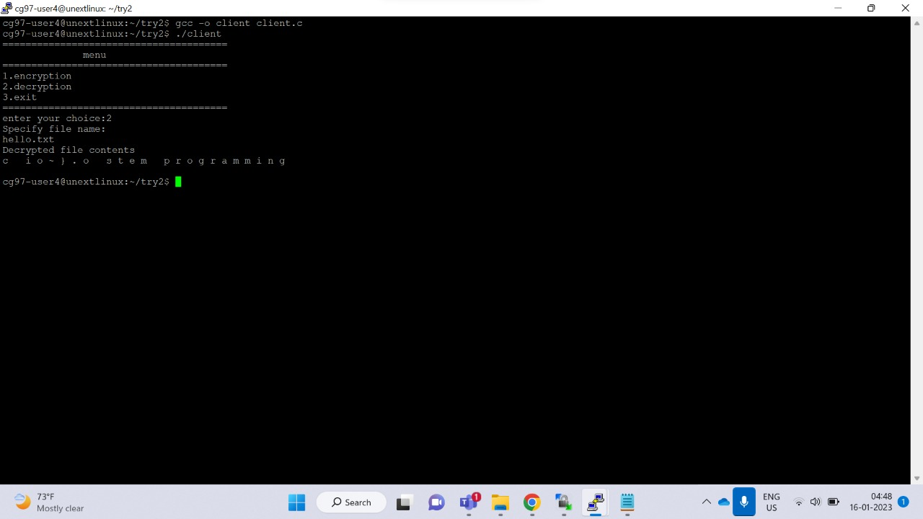
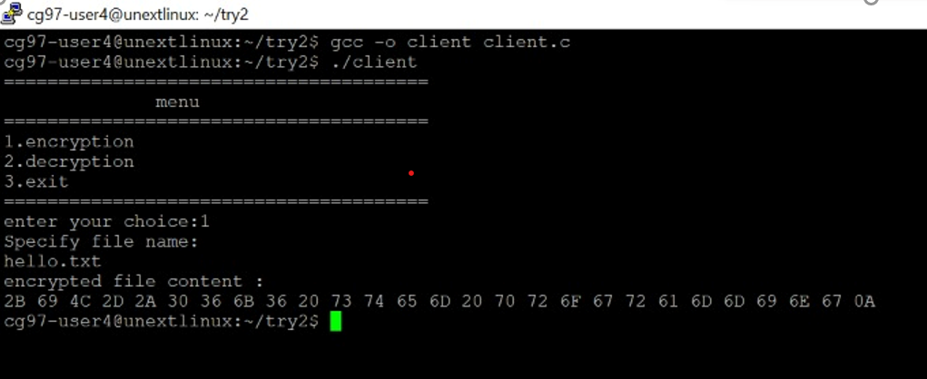
Encryption
Decryption

Slide 15
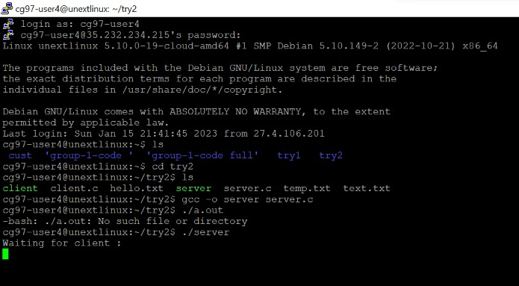
Server Client Establishment

Slide 16

Conclusion
Encryption and decryption are the processes of converting plaintext into ciphertext and vice versa. Encryption is used to secure data by making it unreadable to unauthorized parties, while decryption is used to convert the ciphertext back into plaintext so it can be read and understood. There are many different encryption algorithm and method available, each with their own strengths and weaknesses. Ultimately, the choice of encryption and decryption method will depend on the specific needs and requirements of the user.

Slide 17


FOR THE ATTENTION

